Slide 1
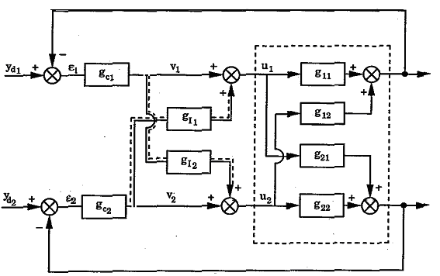
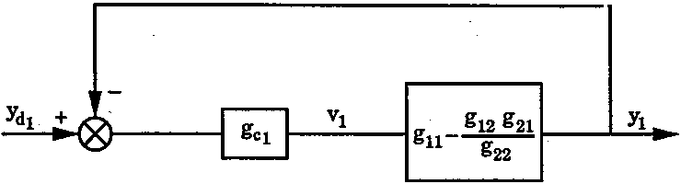
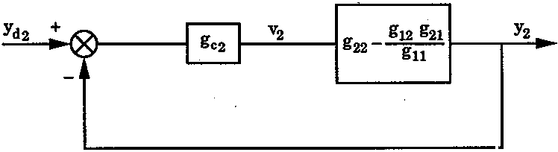
Simplified Decoupling

Slide 2
Generalized Decoupling
MIMO process
To eliminate interactions, y to v : a diagonal matrix; G_{R}(s).
Choose G_{I} such that
Selected to provide desired decoupled behavior with the simplest form
A commonly employed choice

Slide 3
Relation Between the Two Schemes
Simplified decoupling
2 x 2 and 3 x 3 system, the compensator transfer function matrix:
For the desired G_{I} , task is to find
to make GG_{I} diagonal
General decoupling
Final diagonal form GG_{I} specified as G_{R}, then G_{I} can be derived.

Slide 4
Comparison of the Two Methods
Simplified decoupling: much more complicated than G_{R} specified in the Generalized decoupling
Difficult to tune controller
Generalized decoupling: tuning and performance better than for Simplified decoupling
Complicated decoupler

Slide 5
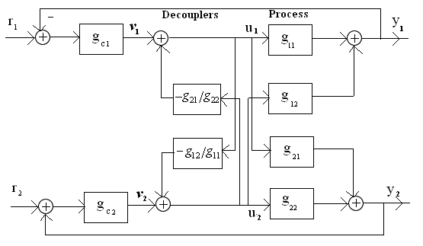
Inverted Decoupling
The required decouplers are the same for the simplified decoupling
The apparent process is the same as generalized decoupling

Slide 6
Steady-State Decoupling
Steady-state gain for decouplers
2×2 system
Simplified steady-state decoupling
Generalized steady-state decoupling
Controller design: assume loops have been decoupled
Very easy to design and implement, first technique to try;
ideal decoupler only if dynamic interactions persistent
big performance improvements with very little work or cost
most often applied in practice.

Slide 7
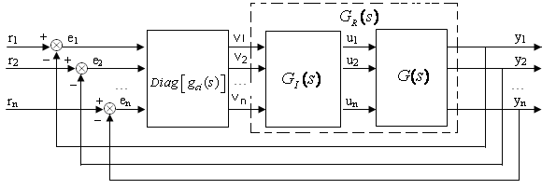
Decoupling Control Structure
Introducing additional transfer function block
Transfer function matrix
is diagonal.
Ideal decoupling
Simplified decoupling
Inverted decoupling

Slide 8
Principals
from
Problem statement: determine
Such that
Realizable: no future values of its input are required to determine its output
Stable: decoupler transfer function must be stable.
Properness: order denominator of decoupler is higher than numerators.
Robustness: so be robust to the parameter variations.

Slide 9
Normalized Decoupling Control Structure

Slide 10
Parameterization
Assuming
Making
The element of the resultant decoupler will have the form

Slide 11
Parameterization
.
.
Stability:
all poles of
must lie in the open Left-Half Plane
Properness:
order higher than or equal to the orders of all
Causality:
satisfied by letting
designed by elements of

Slide 12
Sparse Control
Main controllers (Diagonal): These controllers are to provide desired performance of closed loop control system.
Tracking controller
Off-diagonal controllers: Main task of the off-diagonal controllers is to minimize interactions among loops
Interaction rejection controller
All loops: integrity principle as for decentralized control applies.

Slide 13
Normalized Interaction Index
Put paired loops in diagonal position, define
Relative control performance index (RCPI),
= 0: centralized; ε = 1: decentralized controller
0<ε<1, smaller ε, better overall control system performance achievable, block diagonal controller or sparse controller would be preferred
if all off-diagonal elements less than 0.15, decentralized control can result in satisfactory performances.
If some off-diagonal elements close to 1, block diagonal controller or sparse controller would be preferred

Slide 14
Partial decoupling control
Define
Determine
open-loop forward transfer function
Controllers can then be designed

